Slide 1
Big Mountain Resort

Slide 2
Problem Identification
Current Pricing strategy is based on average resort prices and adding a premium.
Is Big Mountain Resort charging enough based on this pricing strategy?
Will improvements to the facility or cutting costs provide a better value for the lift ticket price?

Slide 3
Recommendations and Key Findings
Big Mountain currently charges $81.00. The modelled price based on other resorts features is $95.87.
Even with a mean absolute error of $10.39 for this model this still shows that Big Mountain is undercharging
The operating costs of a new chair lift is $1,540,000.
Adding an additional run, chair lift, and increasing the vertical drop by 150m will support a price increase of $8.61. Over the season this could increase the sales by $15,065,471.
Therefore it is recommended to add an additional lift to big mountain, which will increase the value of each lift ticket price.

Slide 4
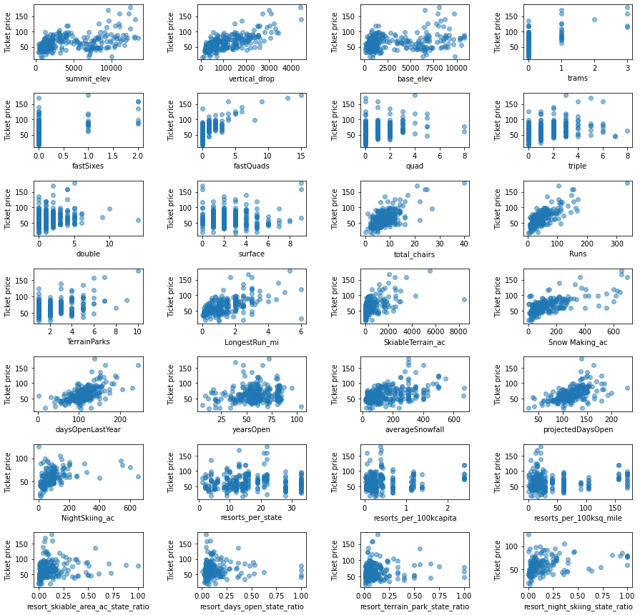
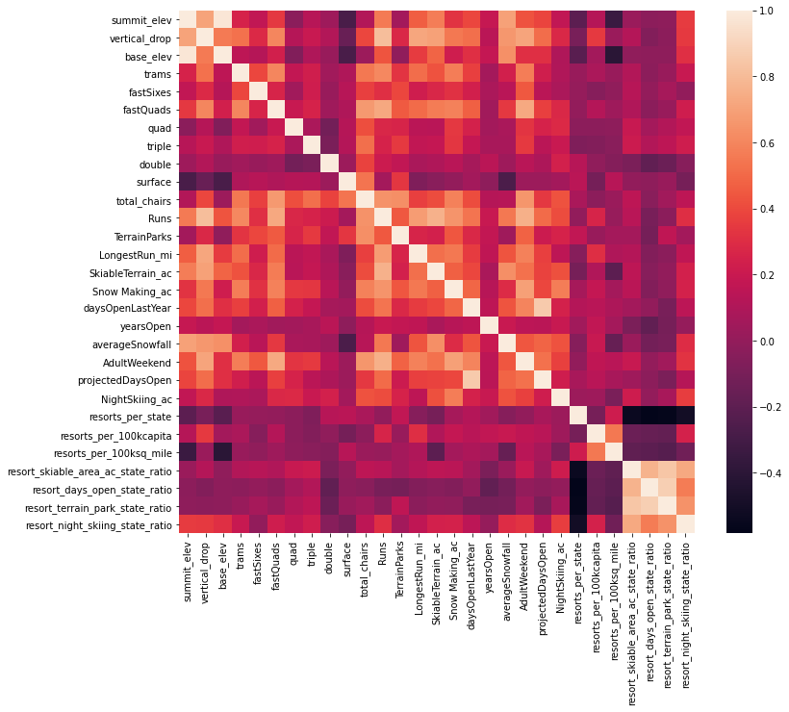
Modeling results and analysis

Slide 5
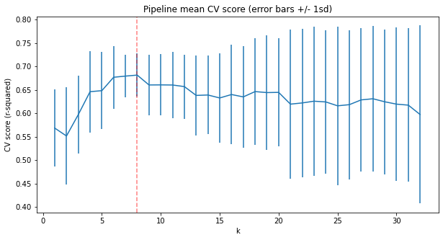
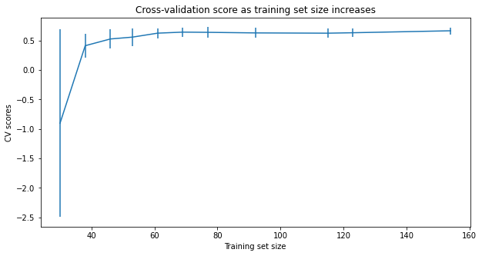
Modeling results and analysis

Slide 6
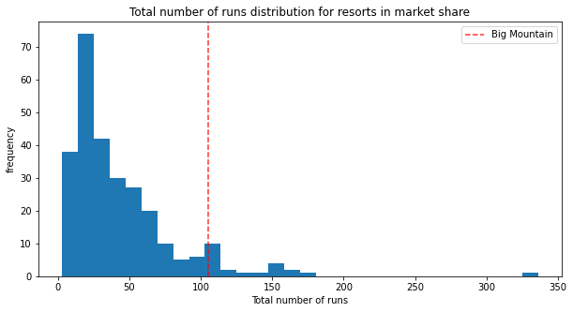
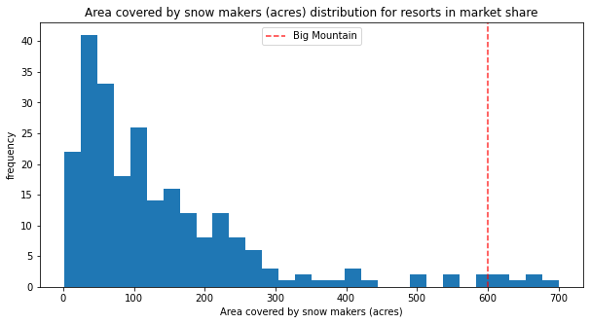
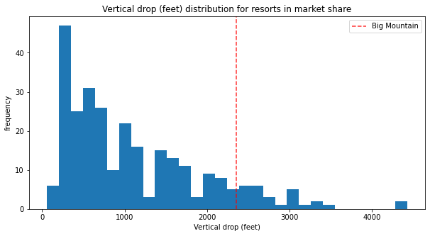
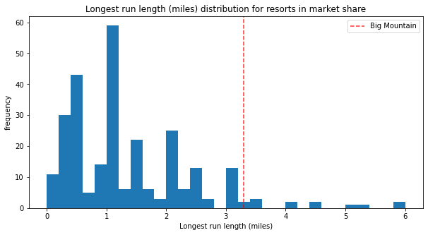
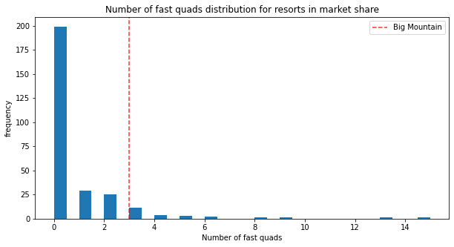
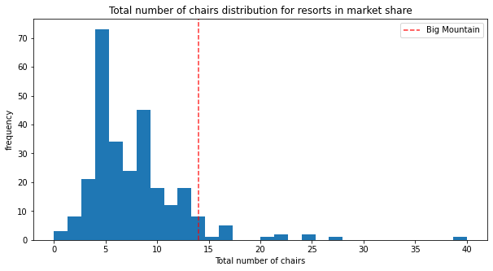
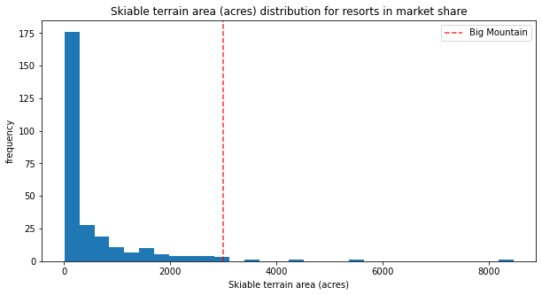
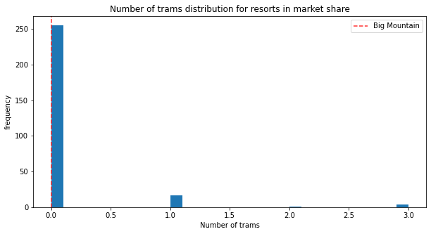
Modeling results and analysis
There are the Features that came up as important in the modeling. Big mountain is well above the average in everything but the number of trams.

Slide 7
Summary and conclusion
Random forest model was the best for this project. It had the highest cross validation score.
There are major features that contribute to lift ticket price, Big Mountain is well above the average for all of these features.
There is already room for a price increase based on the modelled price of Big Mountains current features.
Adding another lift to the resort will add additional value to the lift ticket price.

